Slide 1
Why Public Engagement Matters to China’s Rise in Global Science?
and how Chinese stakeholders have come to realise it
Dr Joy Y. Zhang
y.zhang-203@kent.ac.uk
University of Kent

Slide 2

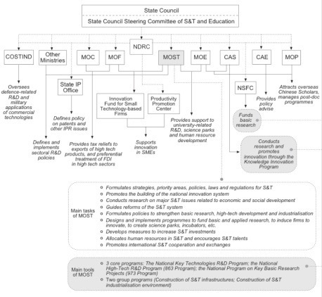
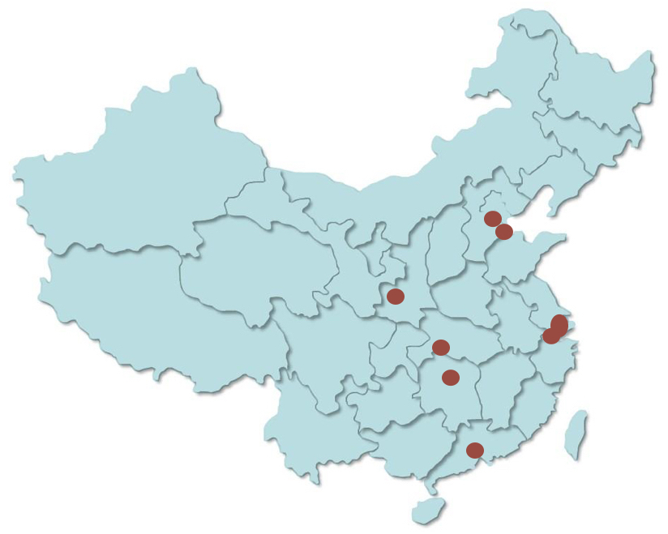
Public/ Public Engagement?

Slide 3
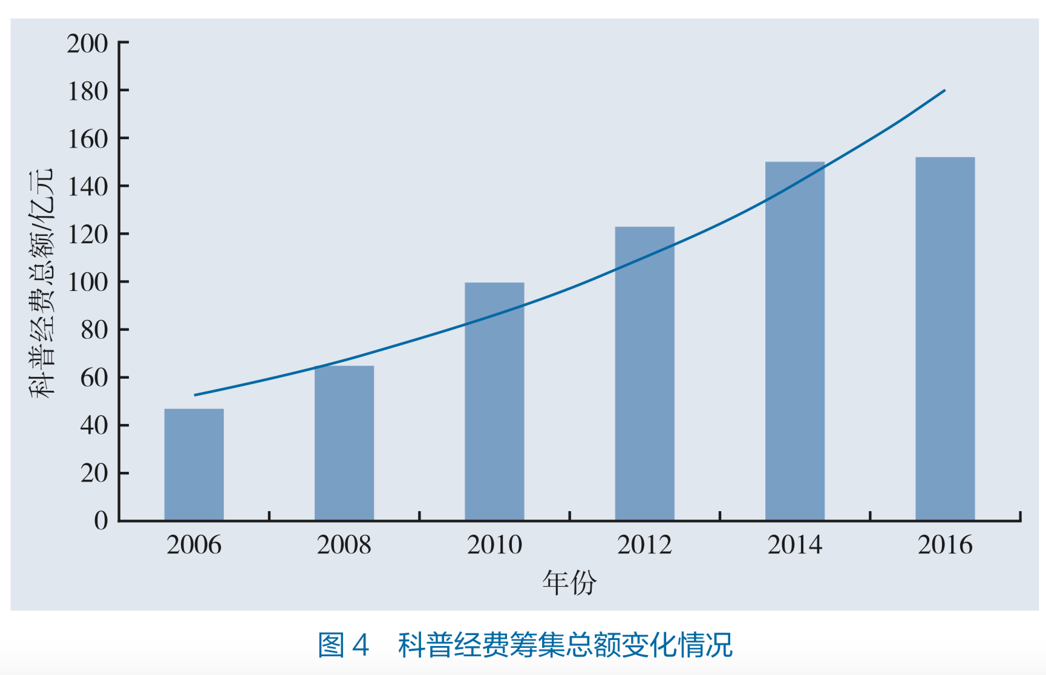

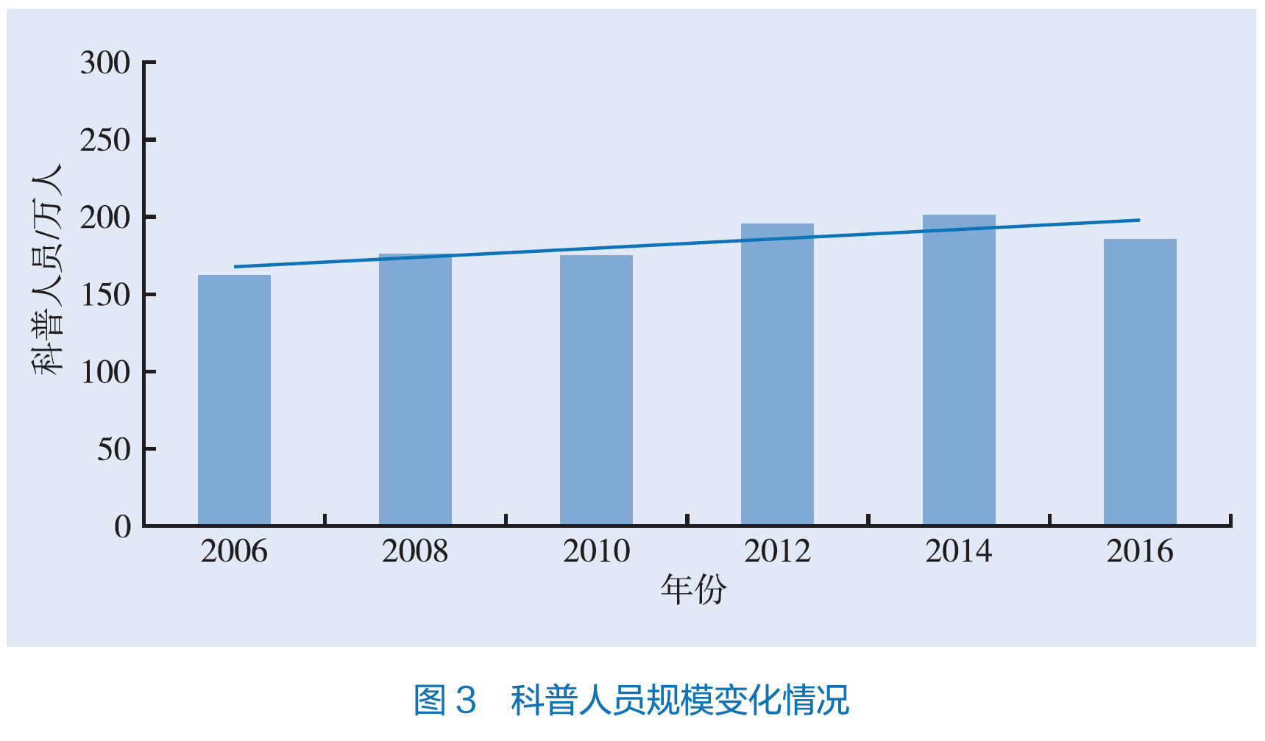

Increased funding
on science popularisation
since 2006
Expansion of science communication
professionals since 2006

Slide 4
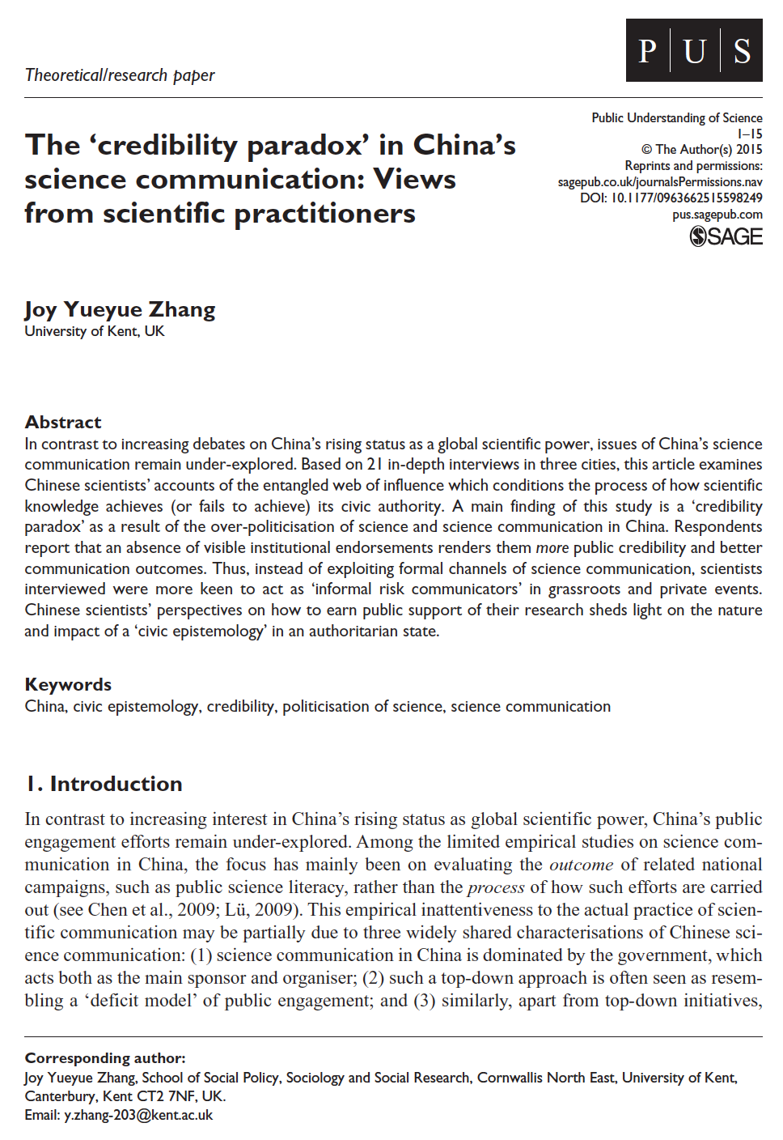
Credibility Paradox
‘accessible’ but not ‘assessable’
The public perception of scientists’ credibility was often inversely proportional to the level of institutional backing.

Slide 5
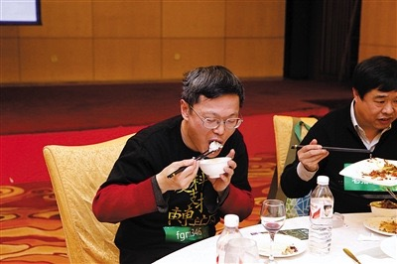

Non-engaging
‘Public Engagements’
“if [the public] are determined to be cynical, then I see no basis for a dialogue.”

Slide 6


Governing Scientific Accountability in China
www.kent.ac.uk/gsa
First UK-China multi-stakeholder public engagement training workshop
UK-China Consortium on Scientific Risks and Public Engagement
Pilot Educational Module Resource (EMR) on public engagement that speaks to Chinese particularities.
Internal policy recommendation submitted to Ministry of Science and Technology
Expanded partnership with the Chinese Medical Association
Spring 2019 widening training with CAS and initiation of ‘EMR 2.0’

Slide 7
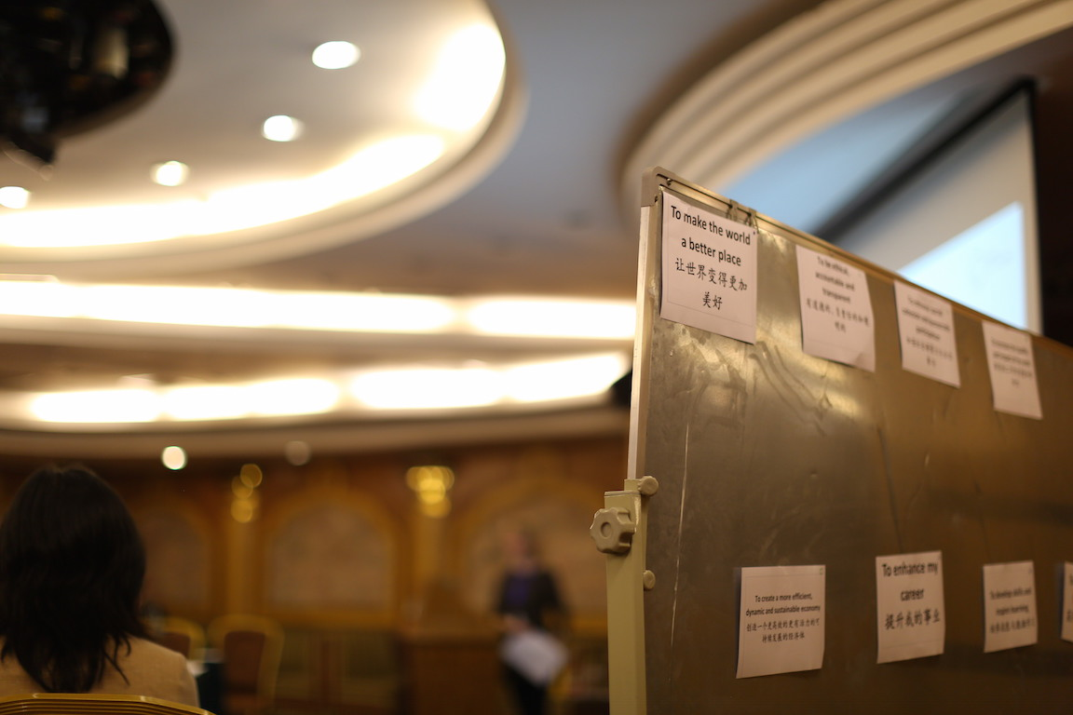

Slide 8
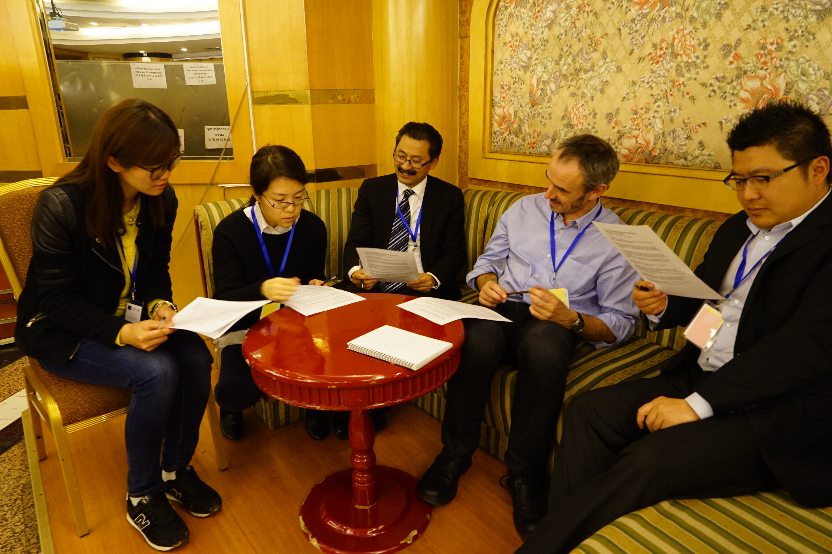

Slide 9
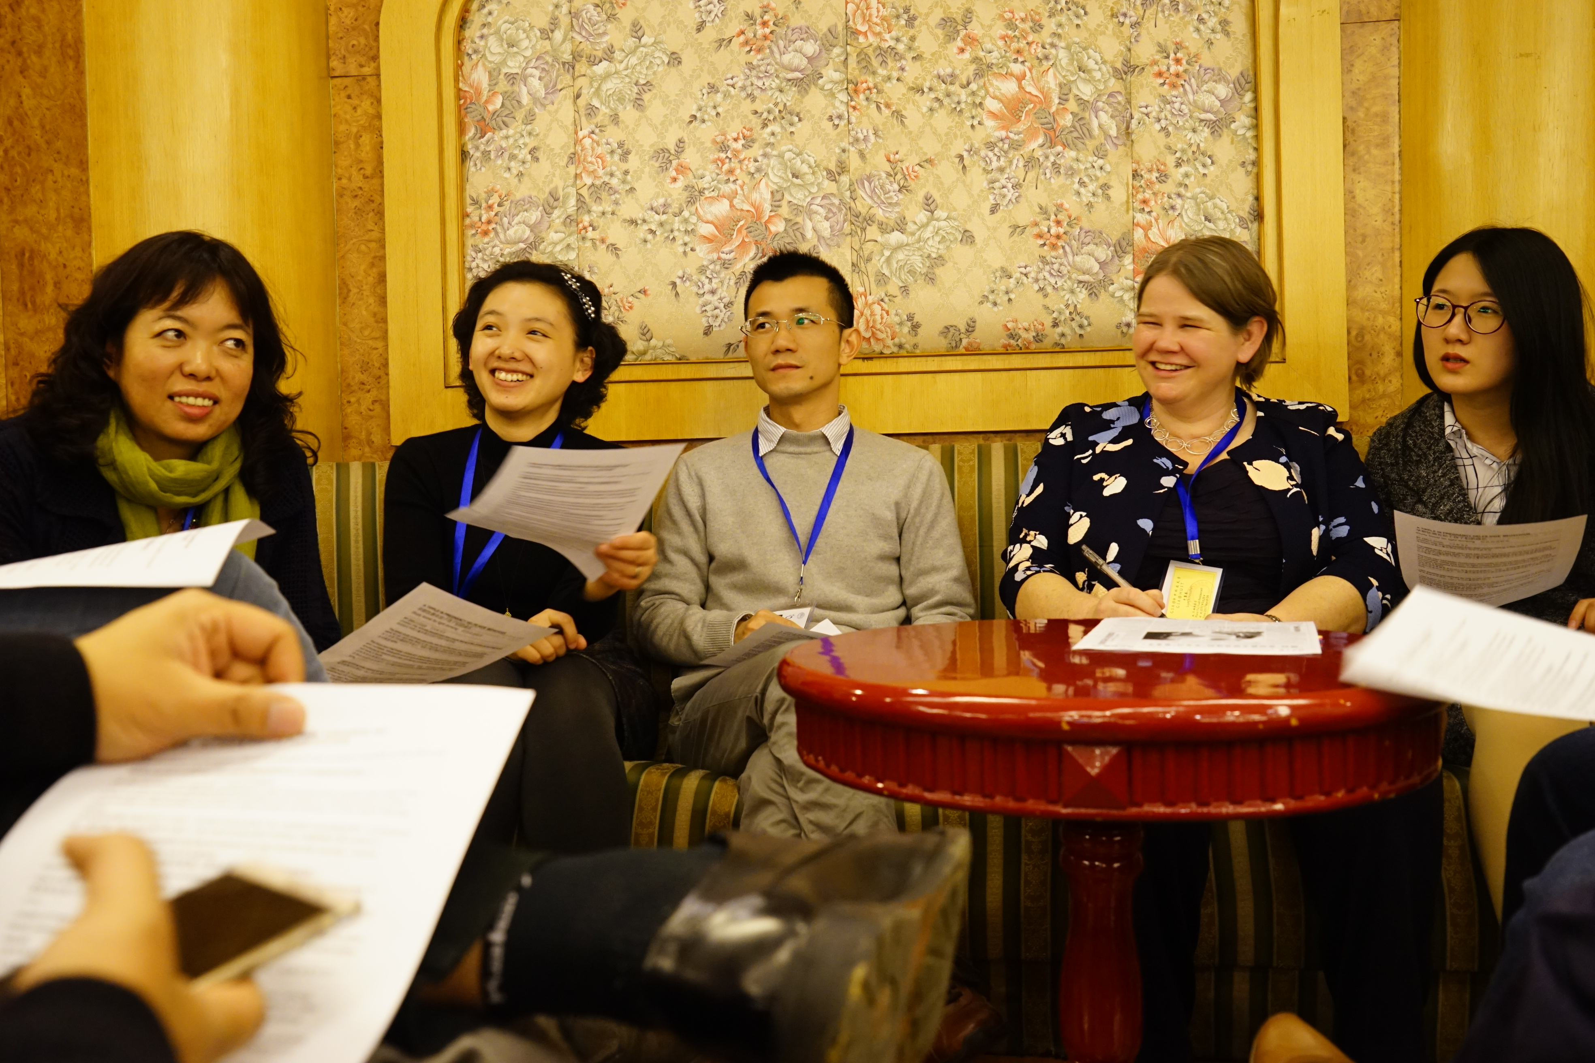

Slide 10
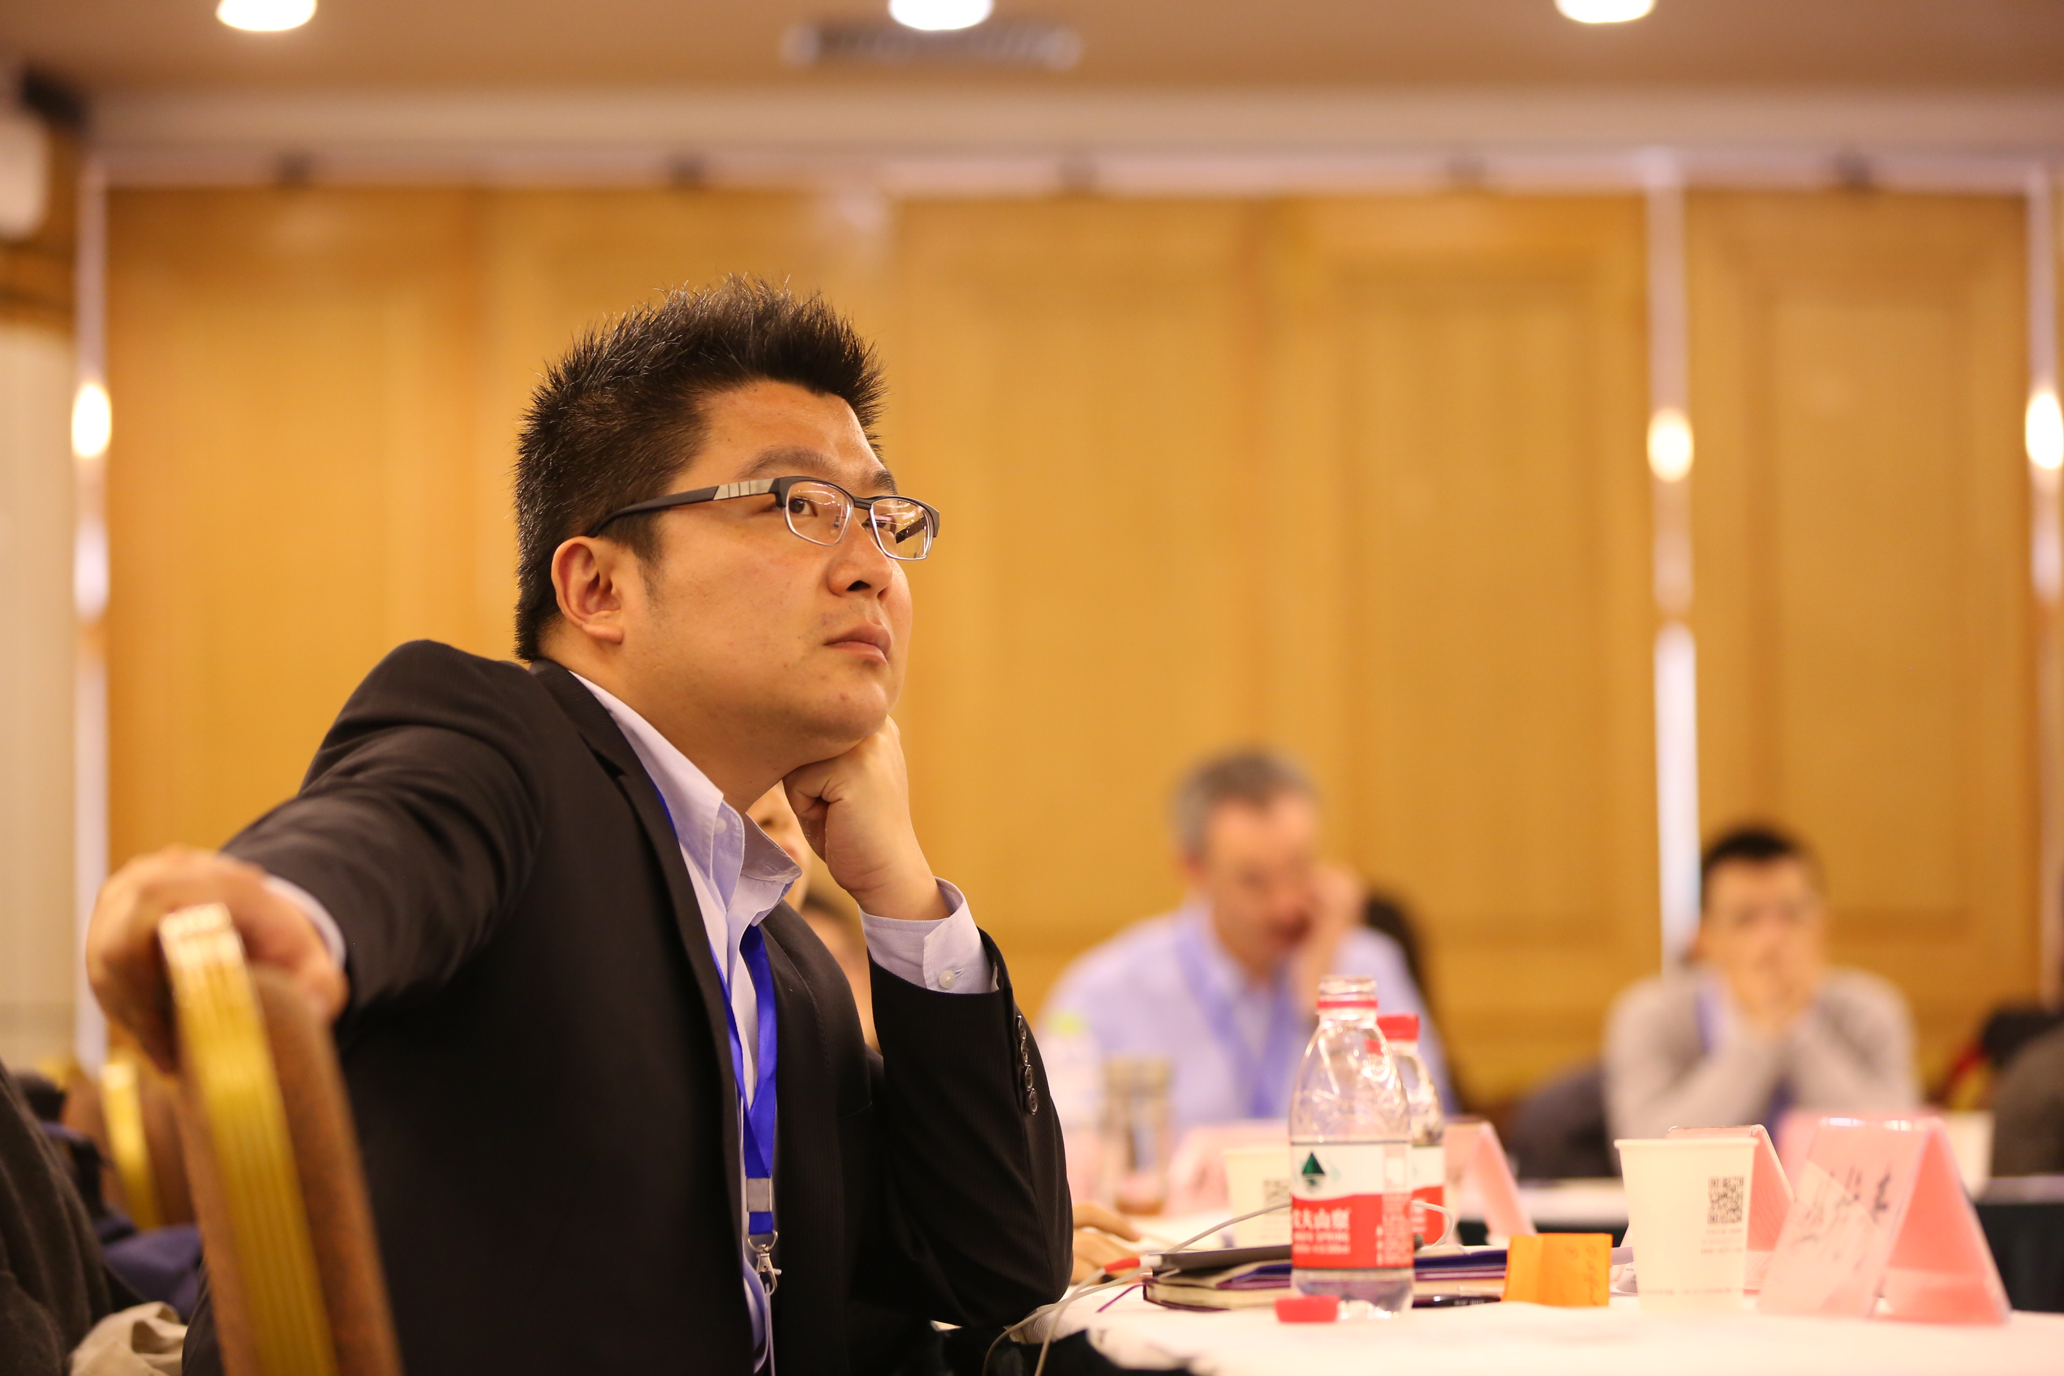

Slide 11
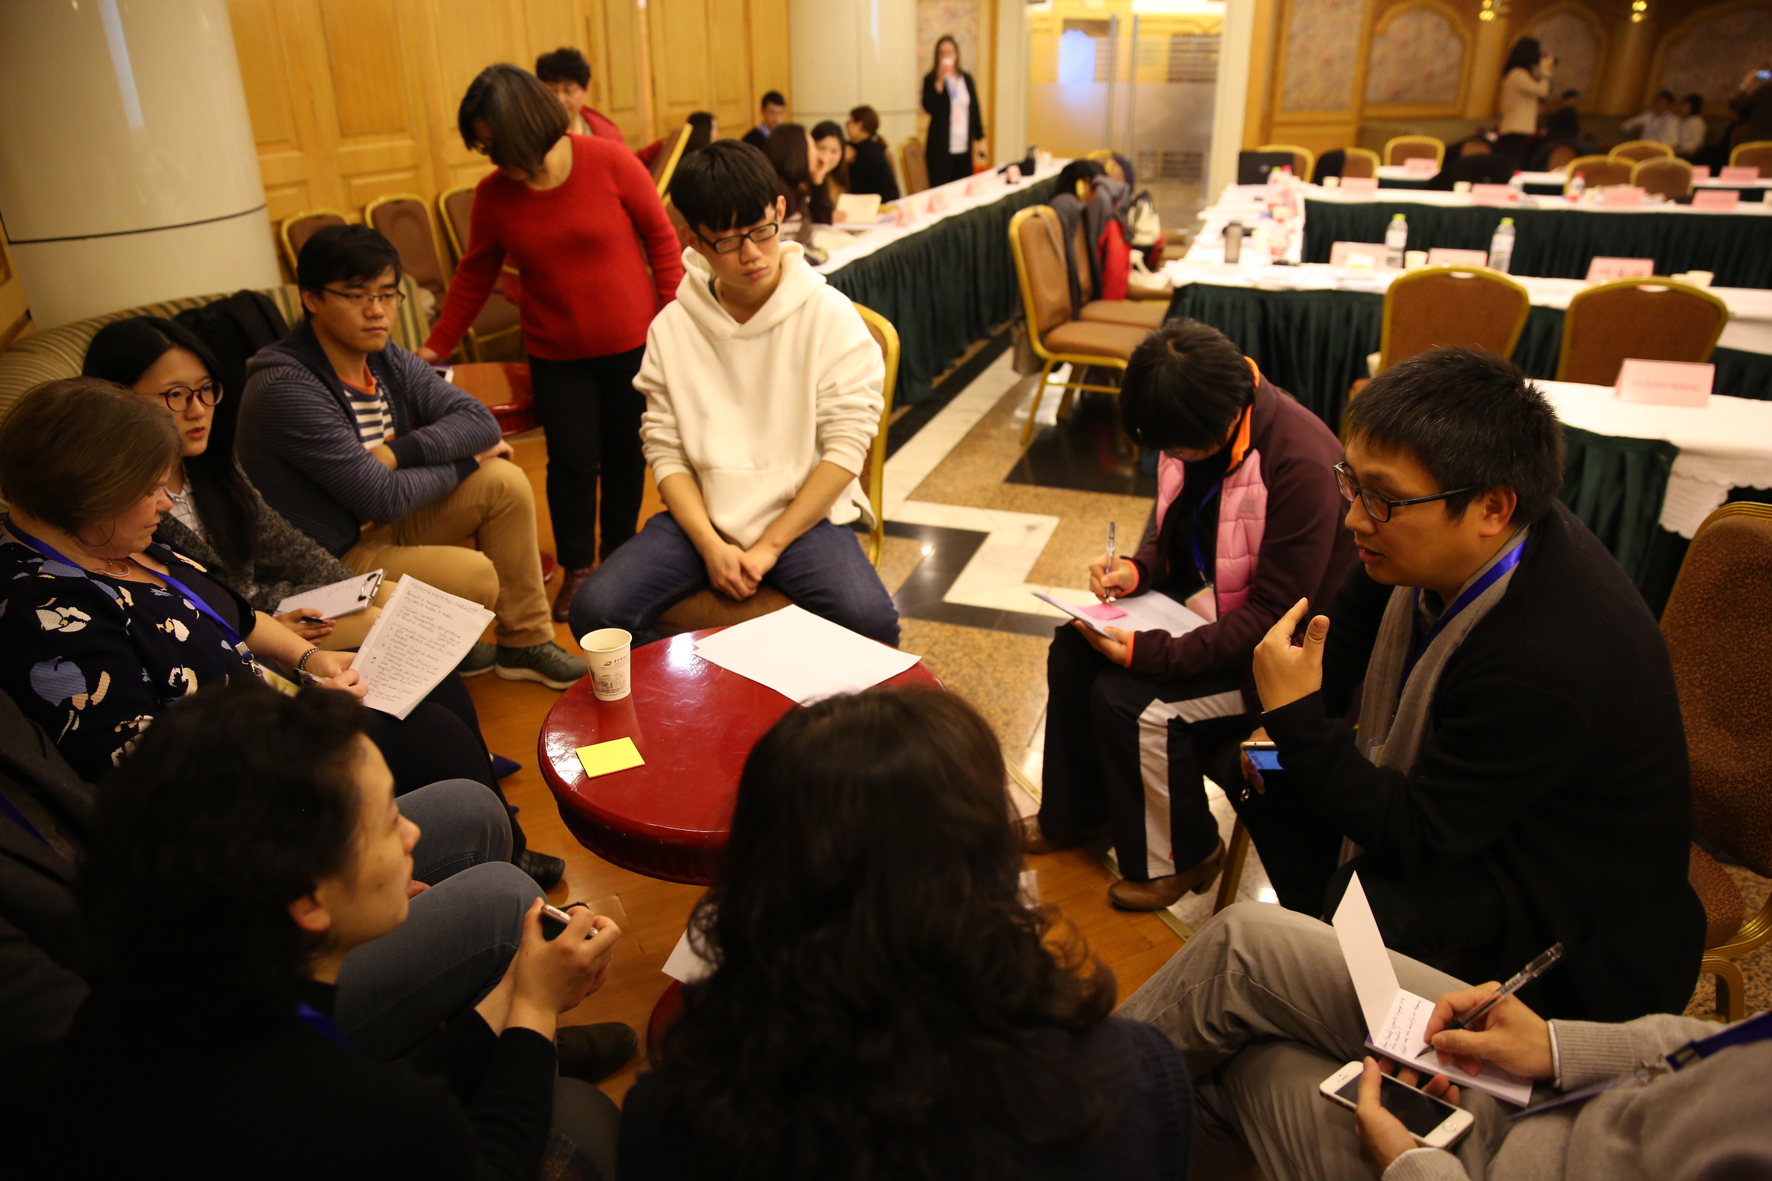

Slide 12
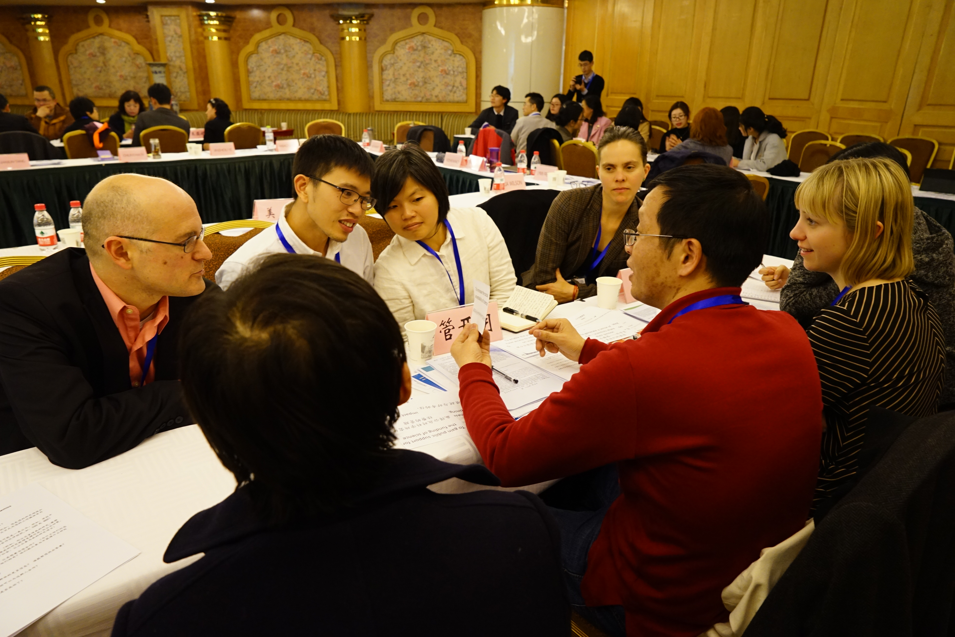

Slide 13
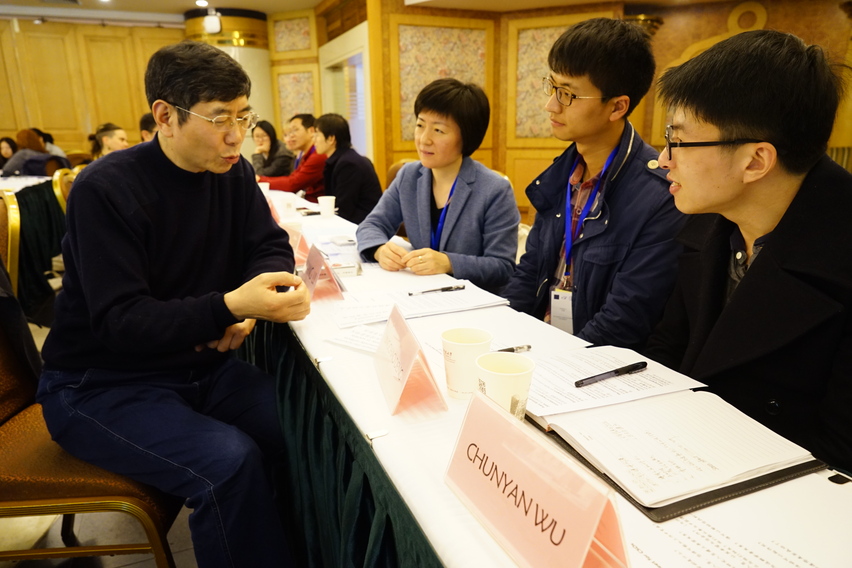


Slide 14
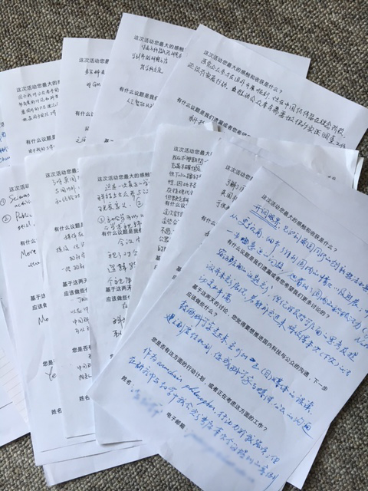
‘I realised that my opposition to GM technology was because I used to have a wrong impression of science… But XXX’s video corrected my suspicion: In fact, scientists are aware of the uncertainties of their work, and they do think about how to plan their research, as well as how to present their data.’
‘This two day event showed that social scientists are just as rational as natural science, or perhaps more “cool-headed” in some cases.’

Slide 15
Institutional
Confidence building + Capacity building

Slide 16
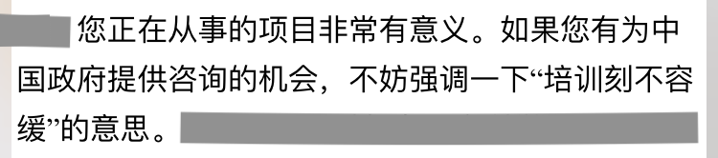
Governing Scientific Accountability in China
www.kent.ac.uk/gsa
First UK-China multi-stakeholder public engagement training workshop
UK-China Consortium on Scientific Risks and Public Engagement
Pilot Educational Module Resource (EMR) on public engagement that speaks to Chinese particularities.
Internal policy recommendation submitted to Ministry of Science and Technology
Expanded partnership with the Chinese Medical Association
Spring 2019 widening training with CAS and initiation of ‘EMR 2.0’

Slide 17
Institutional
Confidence building + Capacity building
(global) Science <== > (global) Society
Co-developing PE capacity for transnational research

